Slide 1
Covid-19 Analysis and Prediction with machine learning algorithms
Presenter: Arshia Ilaty
CS 631 – Spring 2023

Slide 2
introduction:
Preprocess phase
Understanding the data and its types
Handling missing values(null) and duplicated rows
Data cleaning
Scaling and normalization
Feature selection and engineering
Algorithm selection and training phase
LSTM
ARIMA
SARIMA
SVM
PROPHET
Polynomial Regression
Bayesian Ridge Polynomial Regression

Slide 3
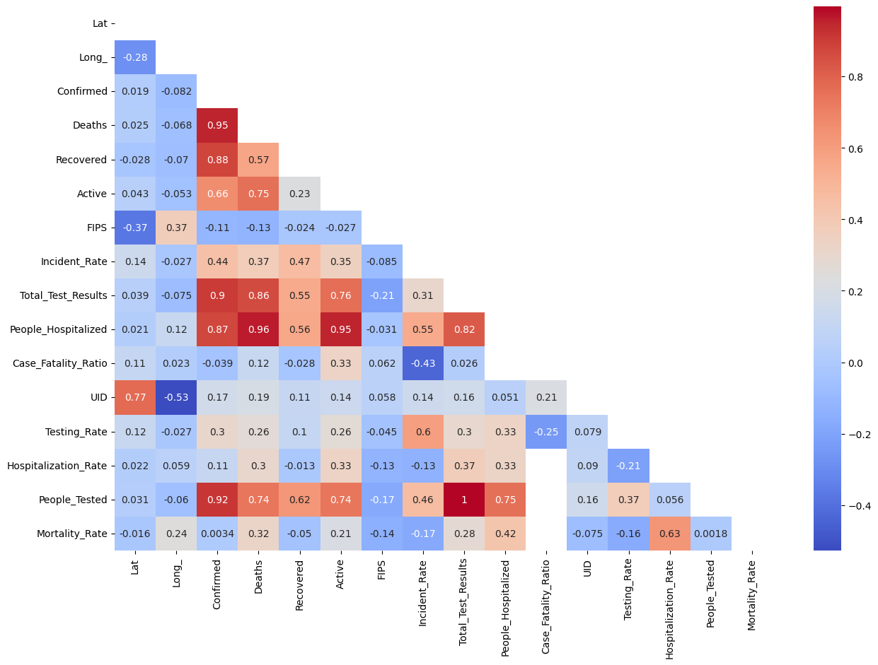
correlation matrix for feature selection and engineering

Slide 4
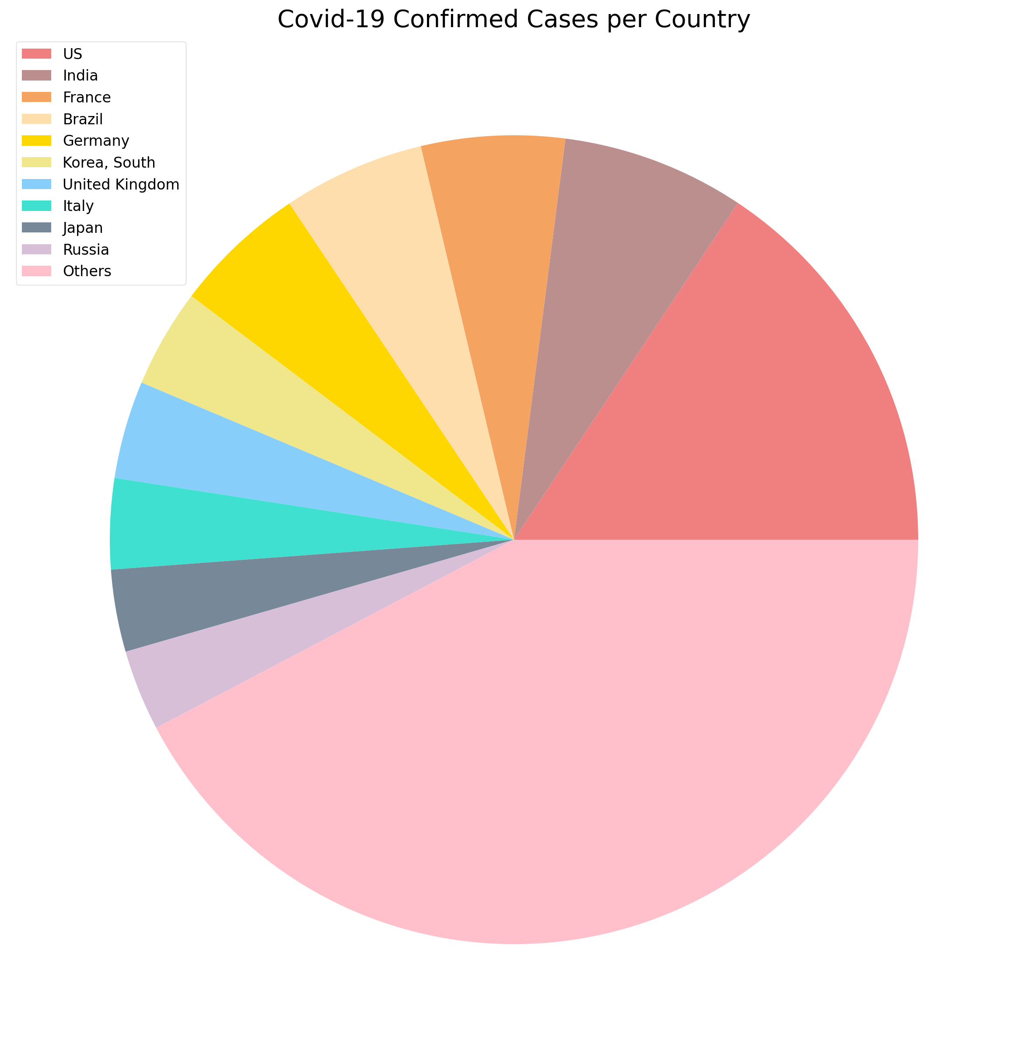
Expected utility of the players in CYBEX game

Slide 5
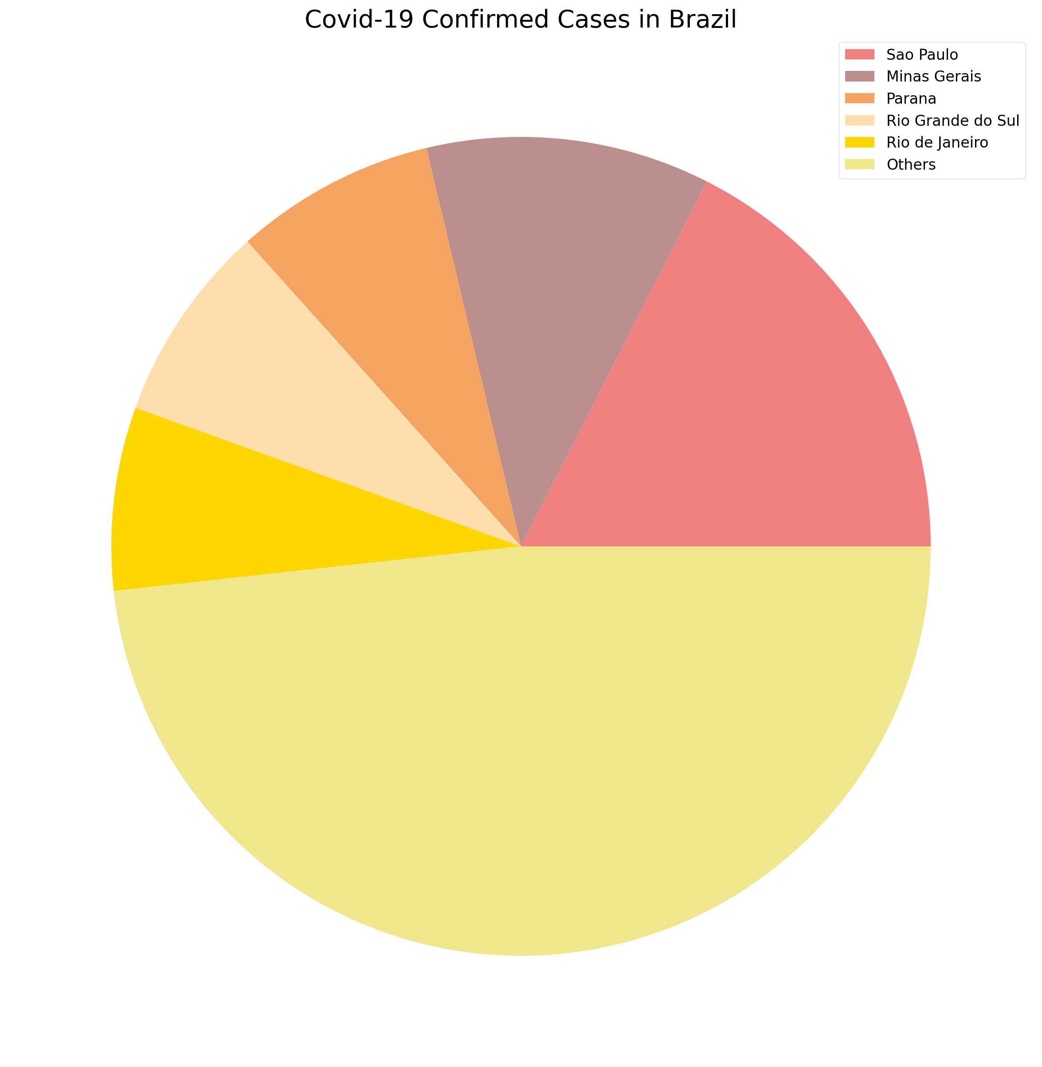
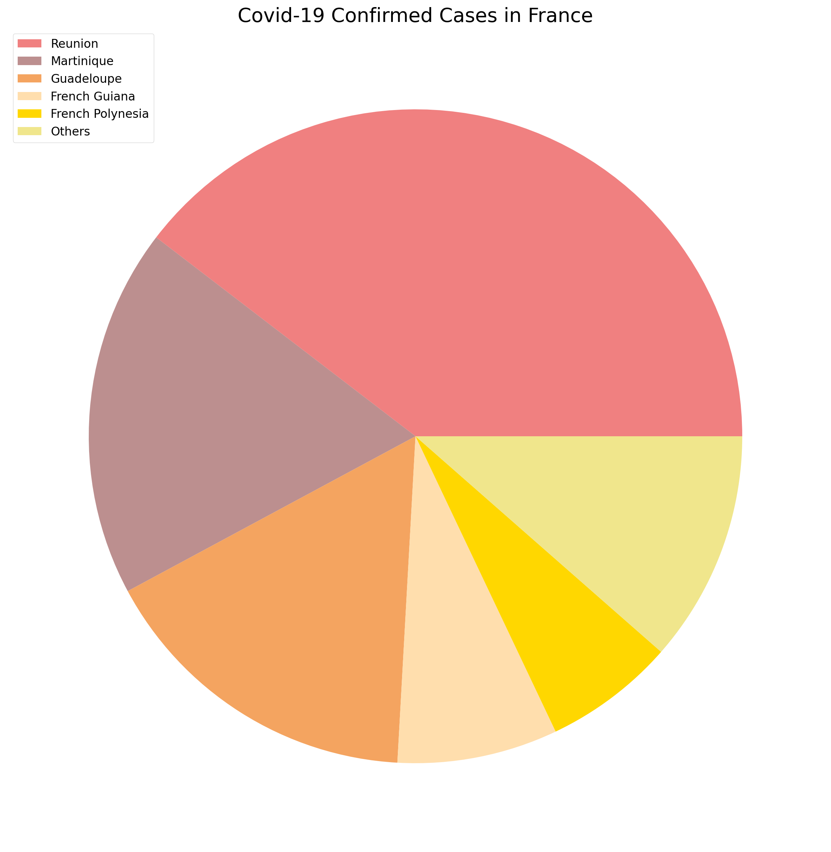
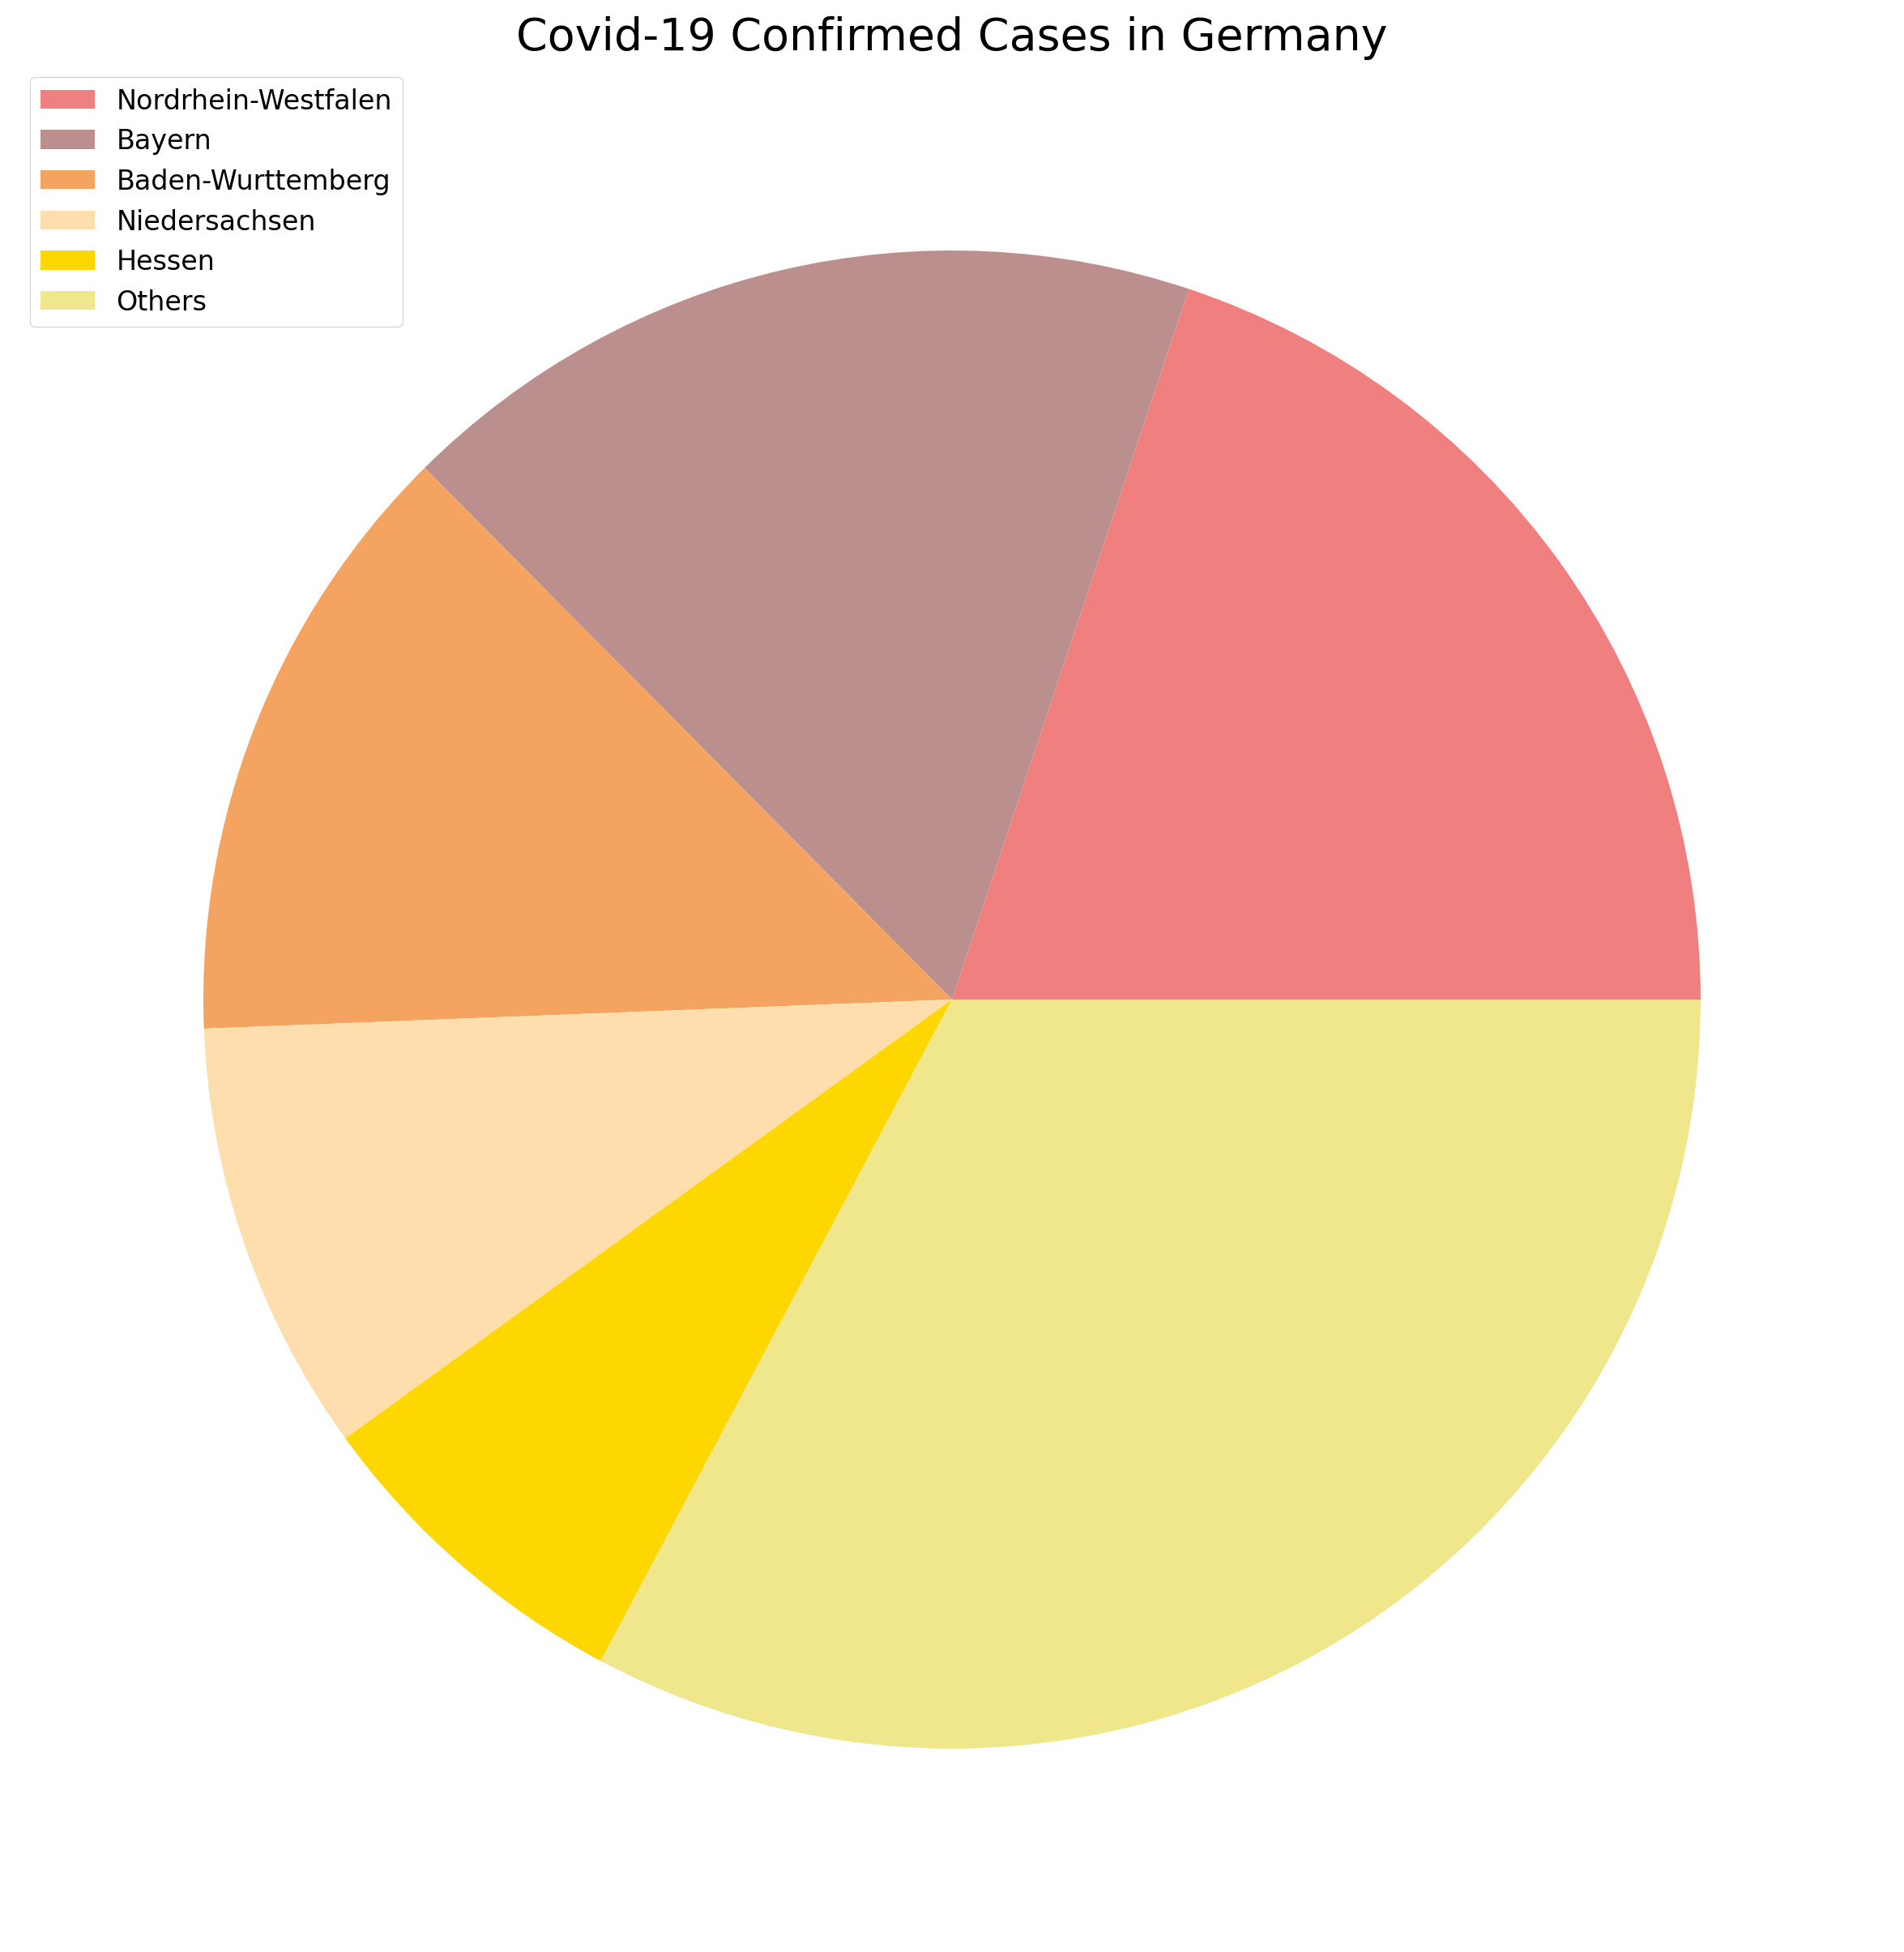
Expected utility of the players in CYBEX game

Slide 6
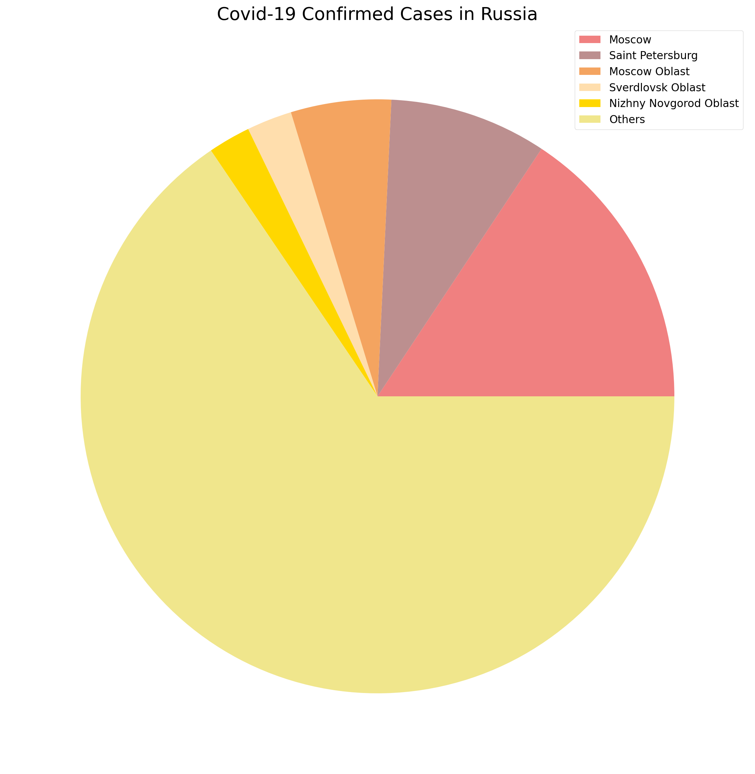
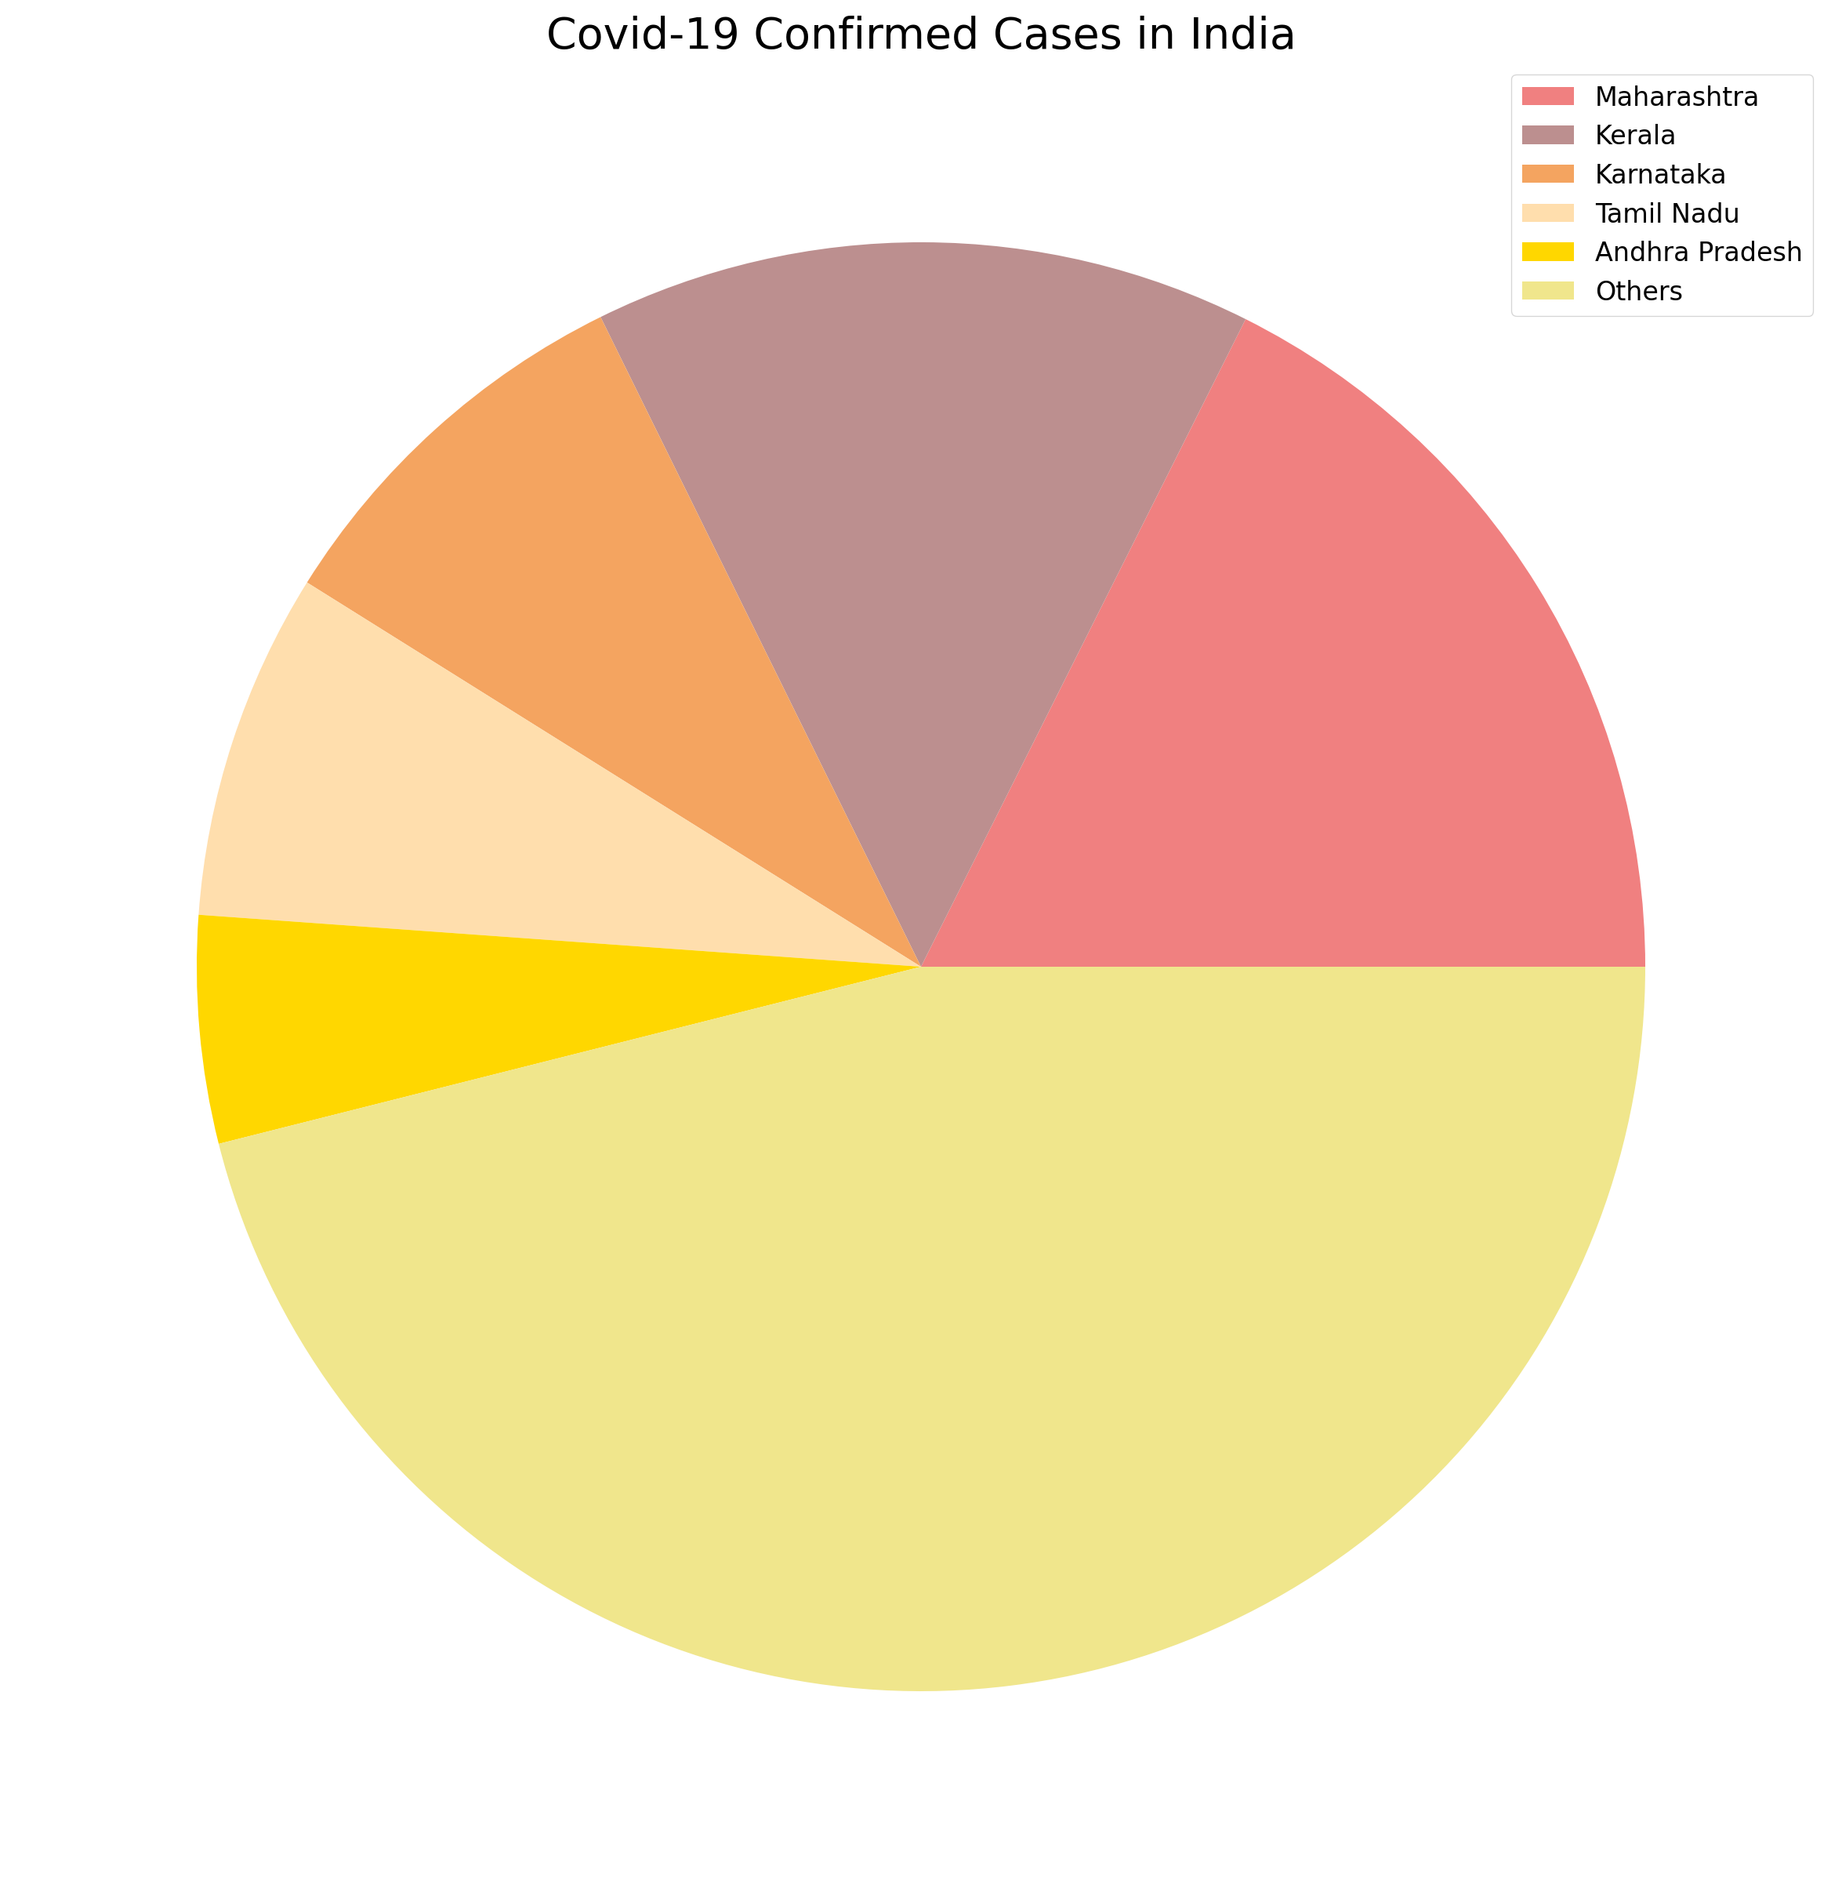
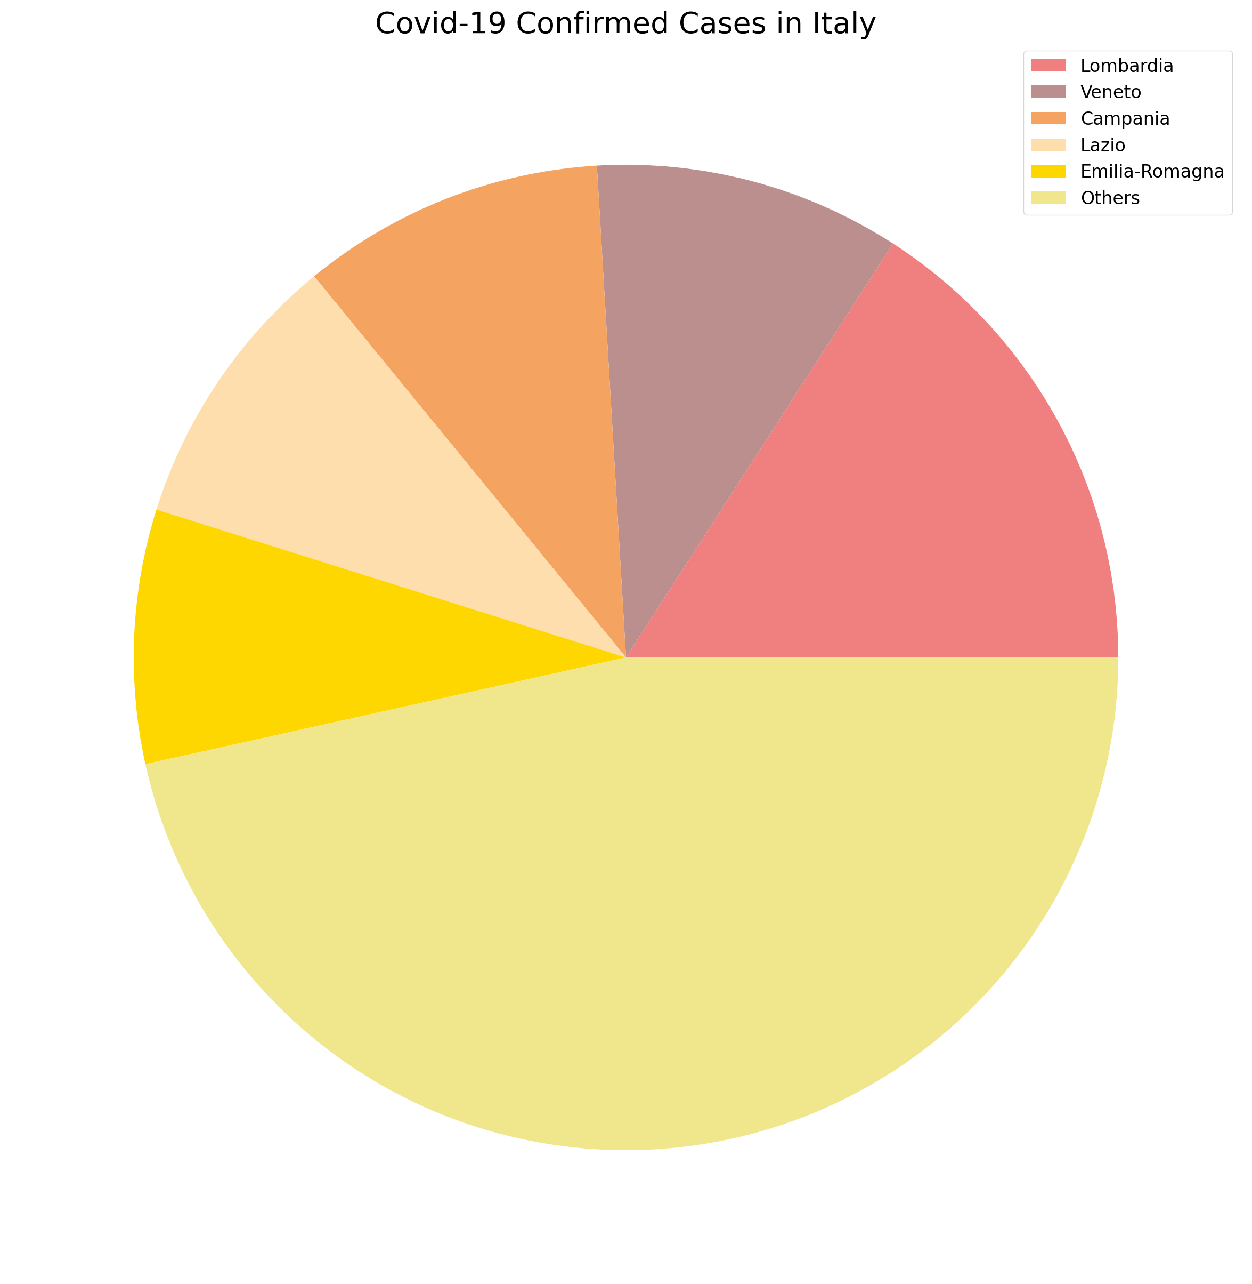
Expected utility of the players in CYBEX game

Slide 7
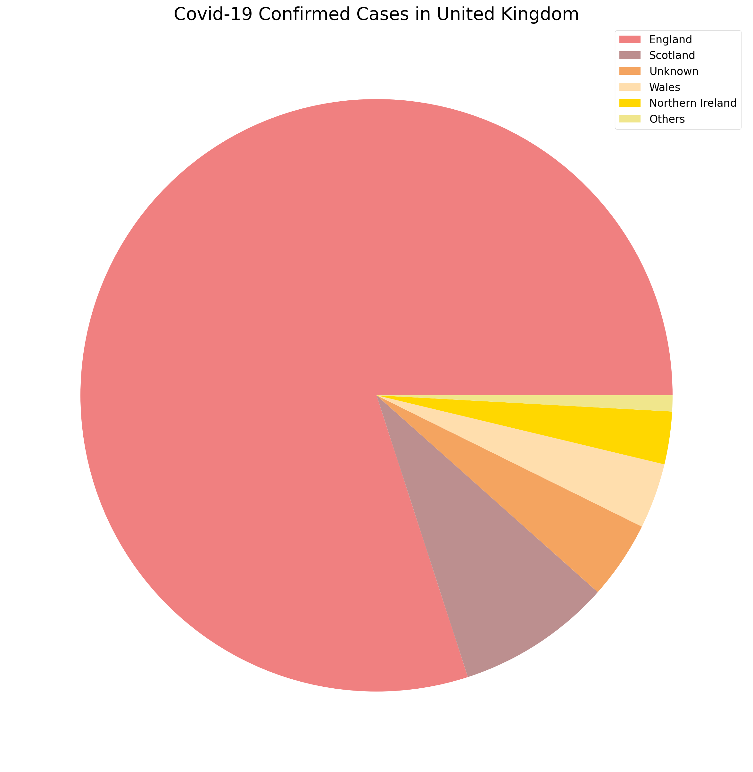
United kingdom analysis

Slide 8
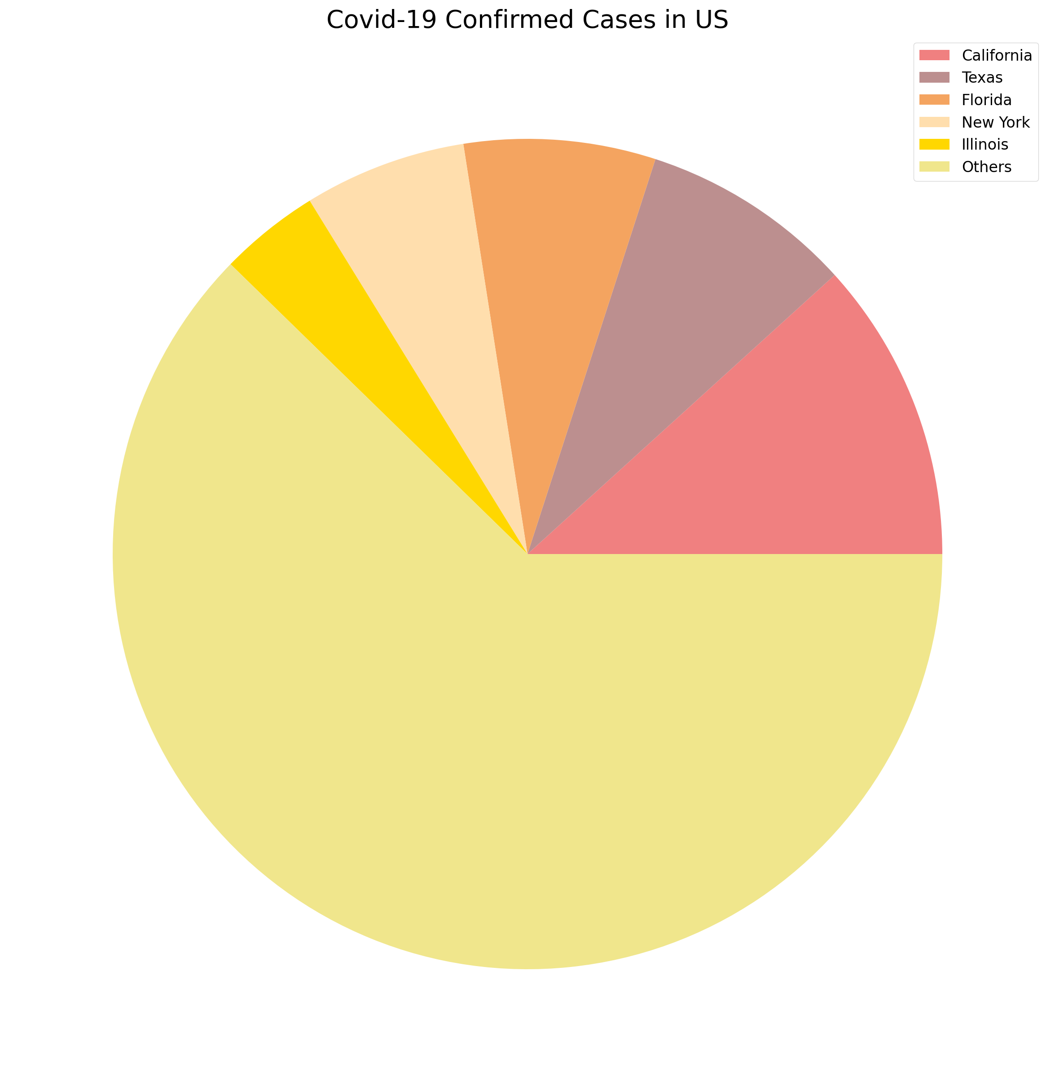
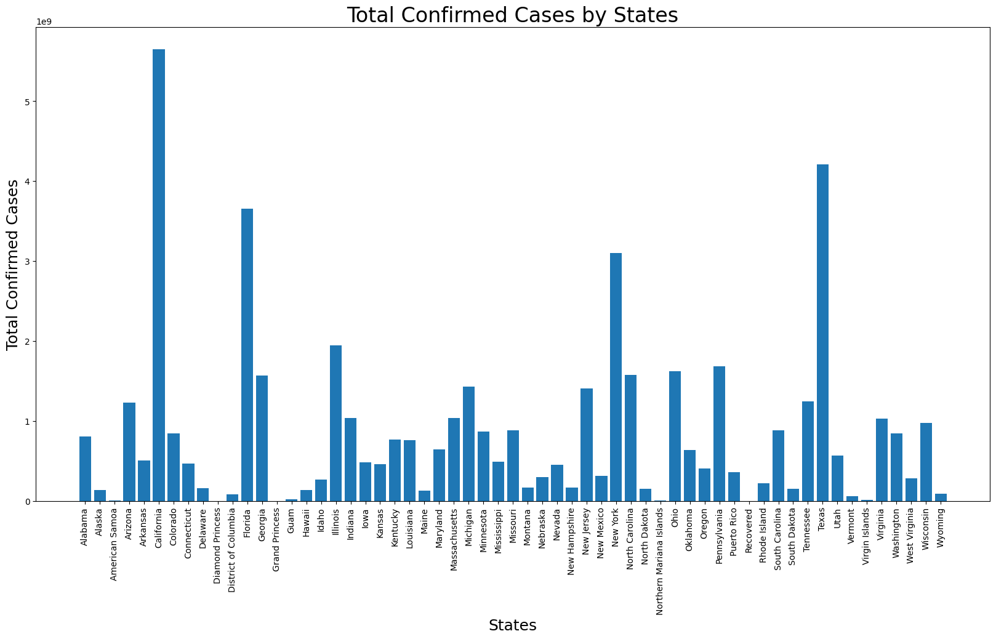
United states analysis

Slide 9
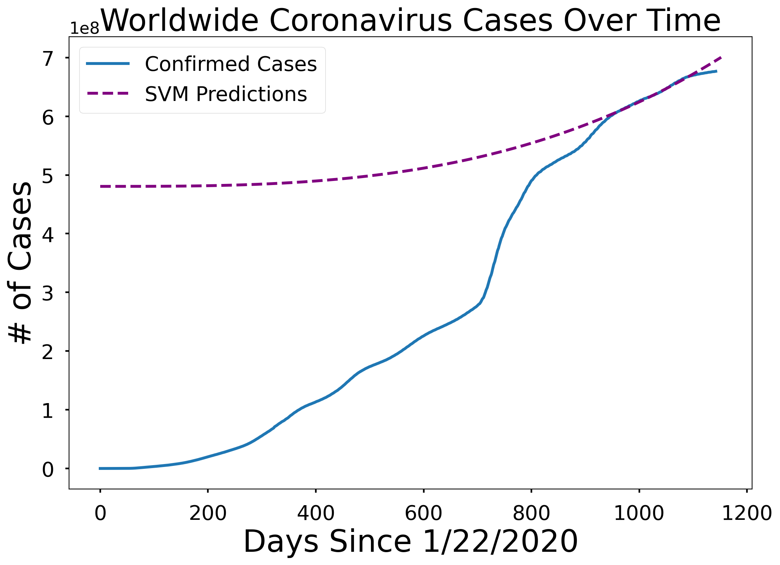
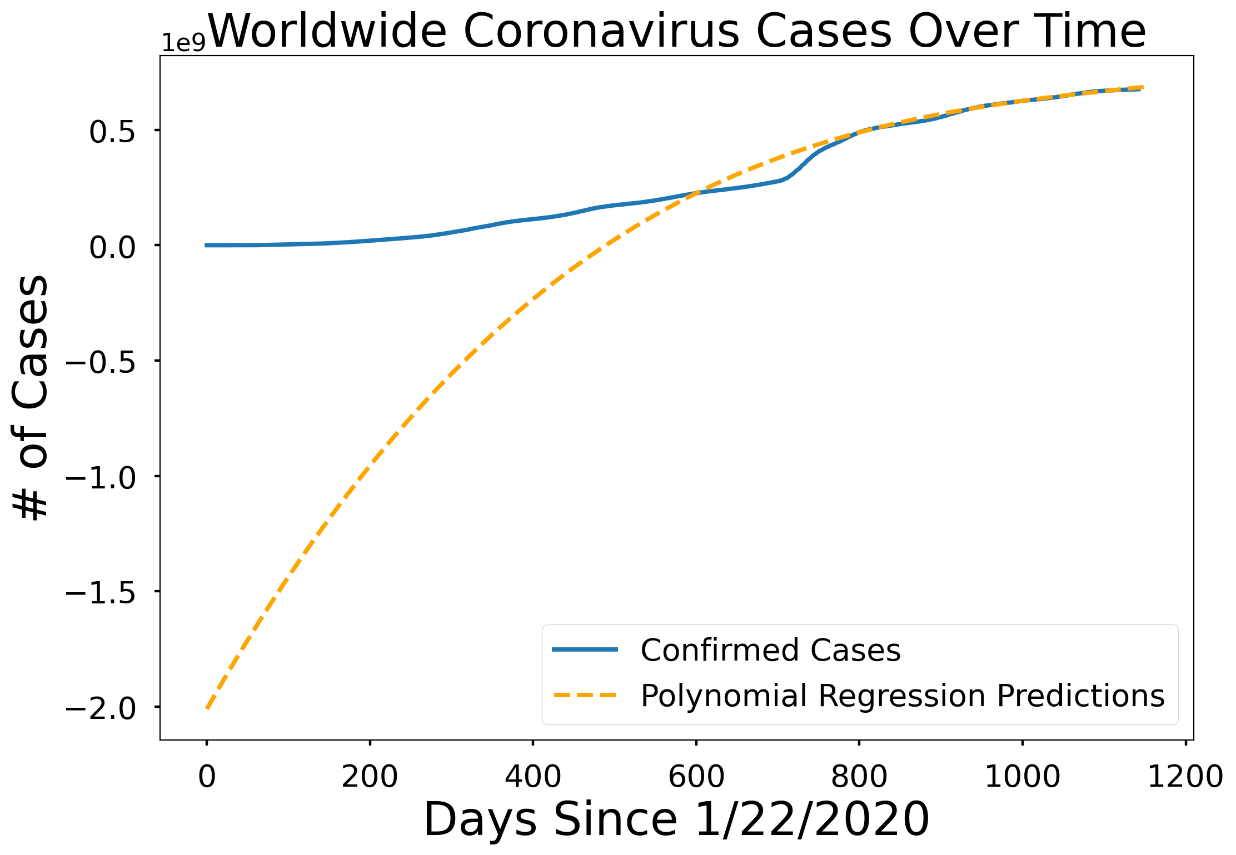
Expected utility of the players in CYBEX game

Slide 10
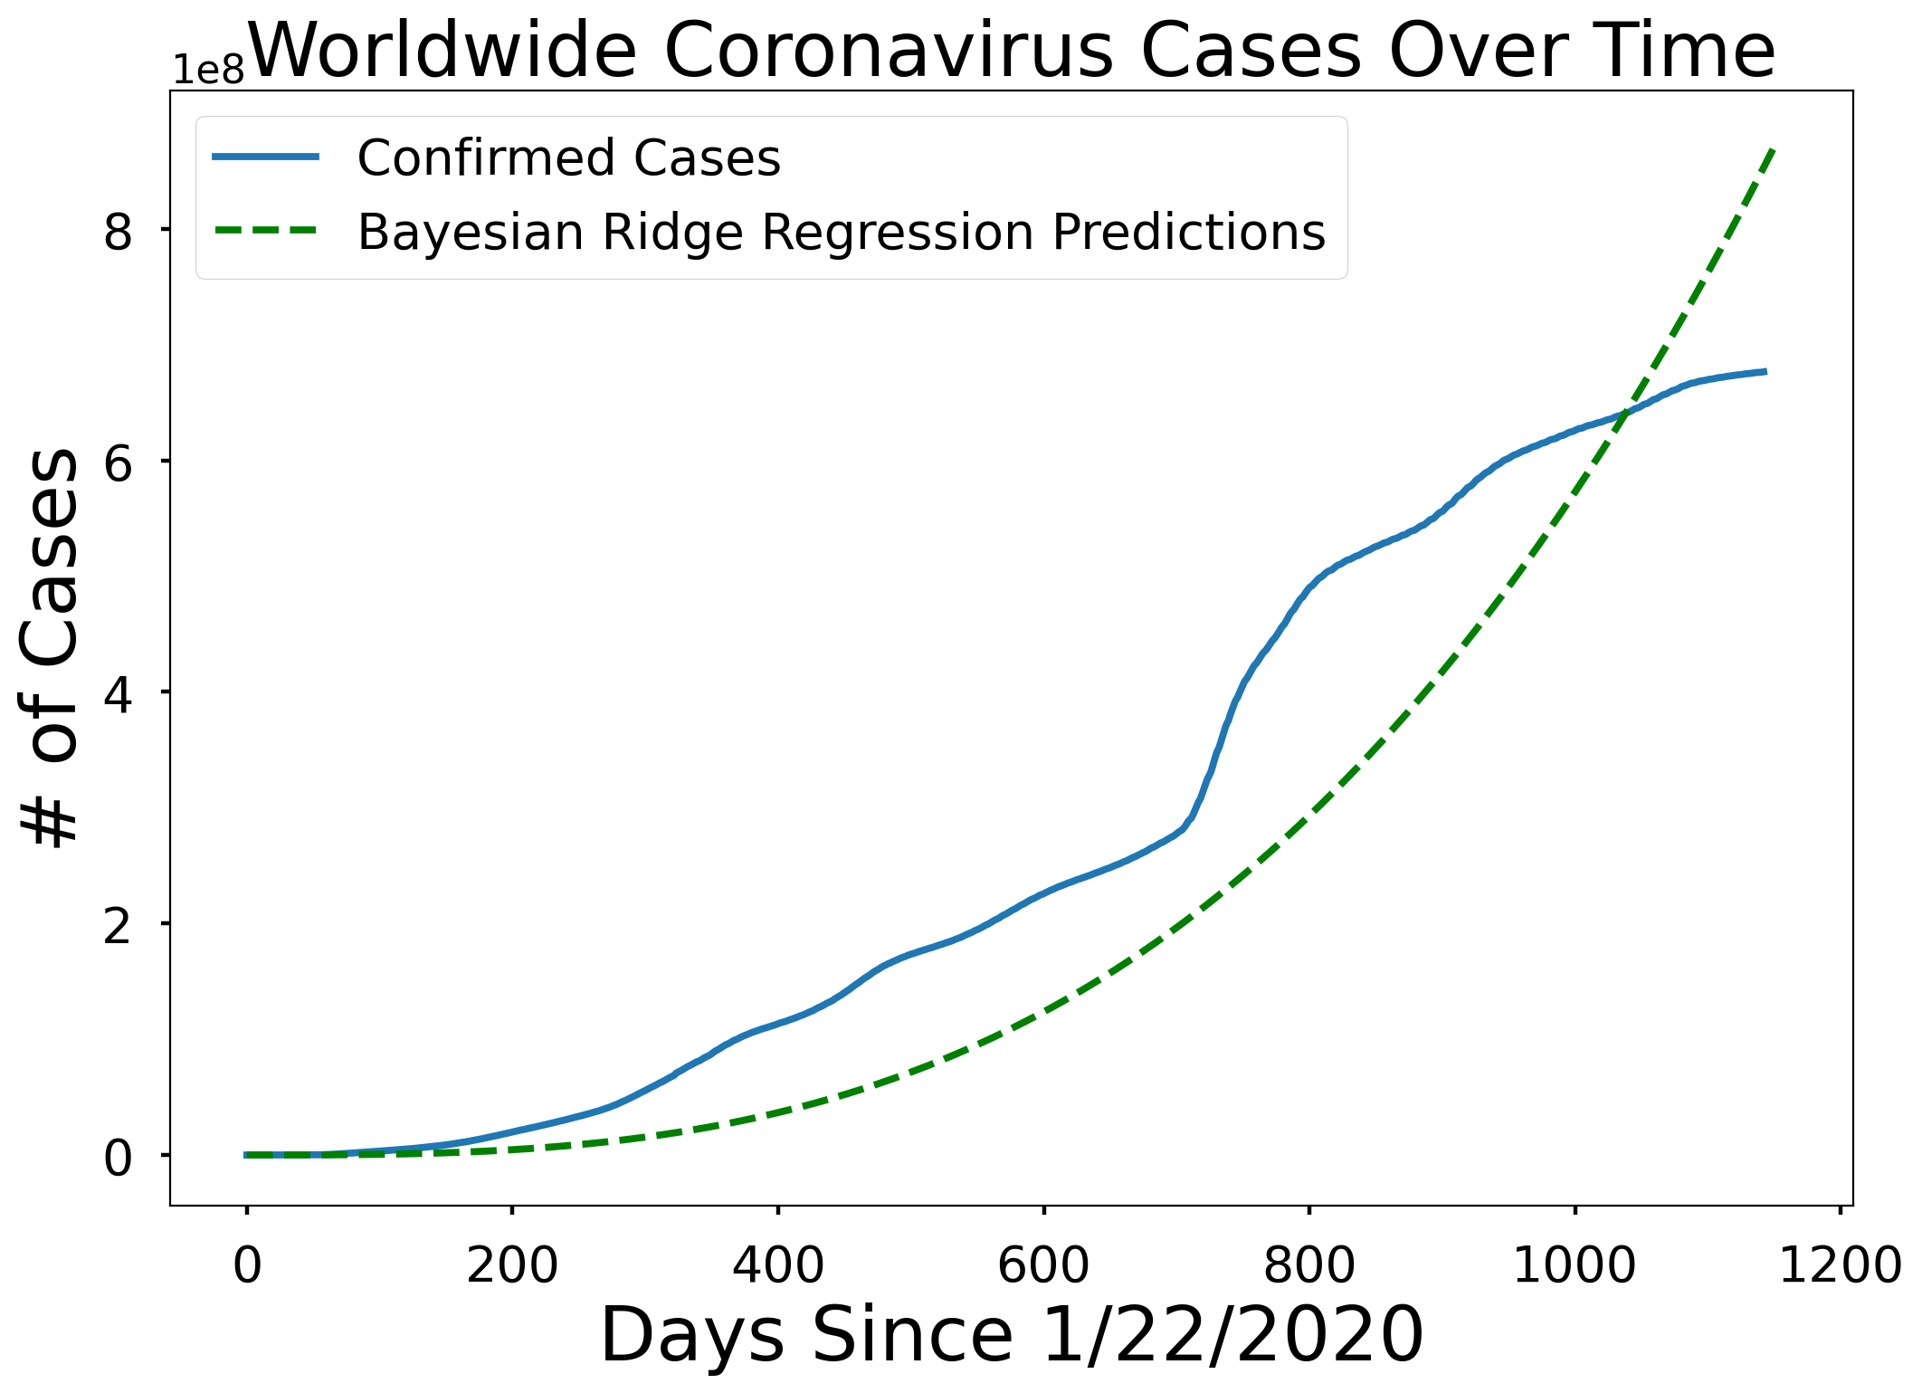
Expected utility of the players in CYBEX game

Slide 11
References and credits
Kaggle crash course (https://www.kaggle.com/learn) + Notebooks
GitHub repositories
Medium posts

Slide 12
Questions, concerns, comments?
Thank you!

